Slide 1
Spiers Magic Wand

Slide 2




The A Team
Matthew Fossett Project Manager
Darrell Smith Hardware Developer
Kevin “Cale” Coor Hardware Developer
Logan Sinclair Software Developer

Slide 3
1.
Project Overview

Slide 4
S.W.A.B.S* Overview
The system will scan a barcode in a given step of the battery recycling process
The system will call ALFRED with the barcode
The “item operation” will also be included with the barcode
ALFRED successfully receives and logs the data
User is given feedback based upon success/failure to access ALFRED
The system will have a fun design (examples at the end)
****Spiers Wireless Auto-Barcode Scanner (S.W.A.B.S)

Slide 5
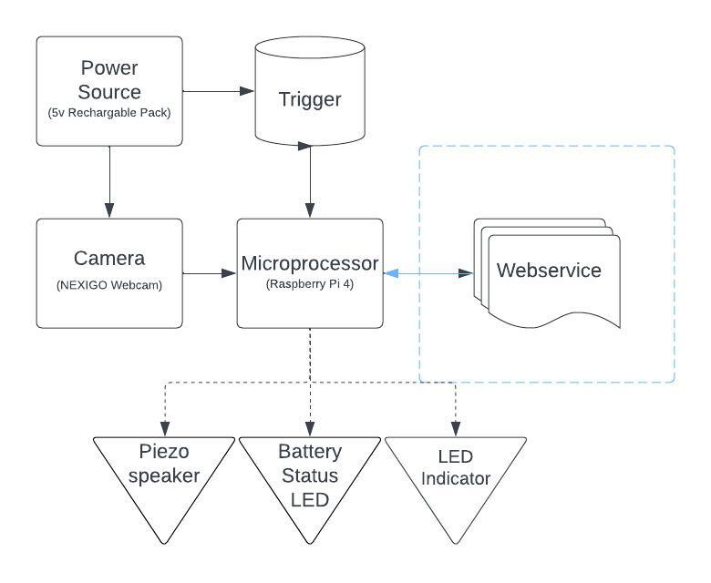
Block Diagram
Necessary parts for the design
Parts listed are theoretical, subject to change
More features may be added

Slide 6
Timeline
Group is created and brainstorming begins
Preliminary Design Review
Power System works and is capable of running the entire system
Critical Design Review
Barcodes are able to be scanned and sent to ALFRED
Begin building fun housings for the system
JAN
FEB
MAR
APR
MAY
Parts are chosen and preliminary design begins
Software and Hardware begin initial builds
Camera is able to interface with Raspberry Pi
A suitable housing for the system is designed and produced
System receives signal from ALFRED if operation is accepted
Final Demonstration and Presentation

Slide 7
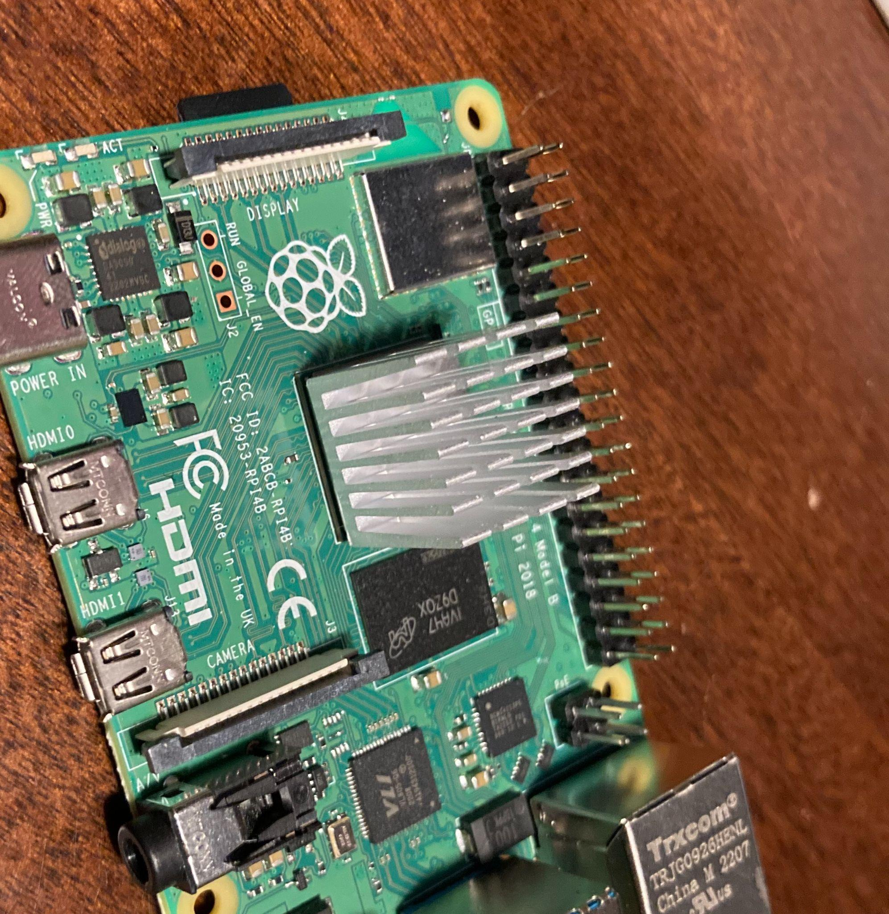
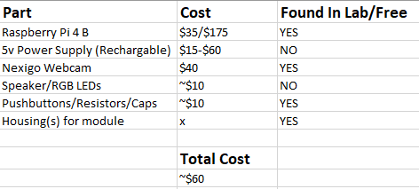
Cost Analysis
Many parts were able to be scavenged from the lab room
The housing(s) for the scanner will be printed using OU’s 3D printers
Raspberry PI 4 Model B
Found in the lab

Slide 8
2.
Microprocessor

Slide 9
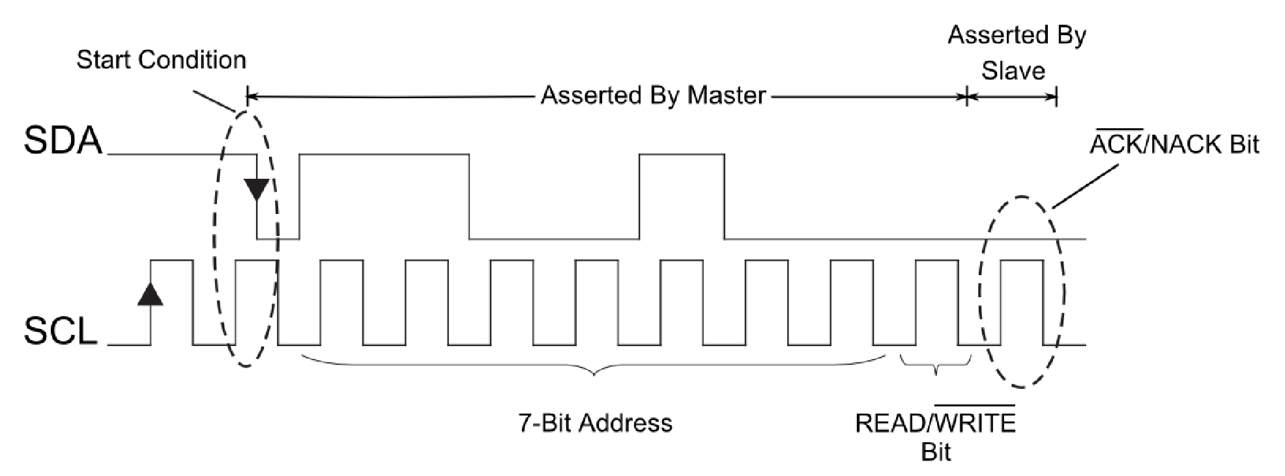
Requirements
I2C/SPI/UART/USB Interface for chosen scanner module
General IO pins for LEDs

Slide 10
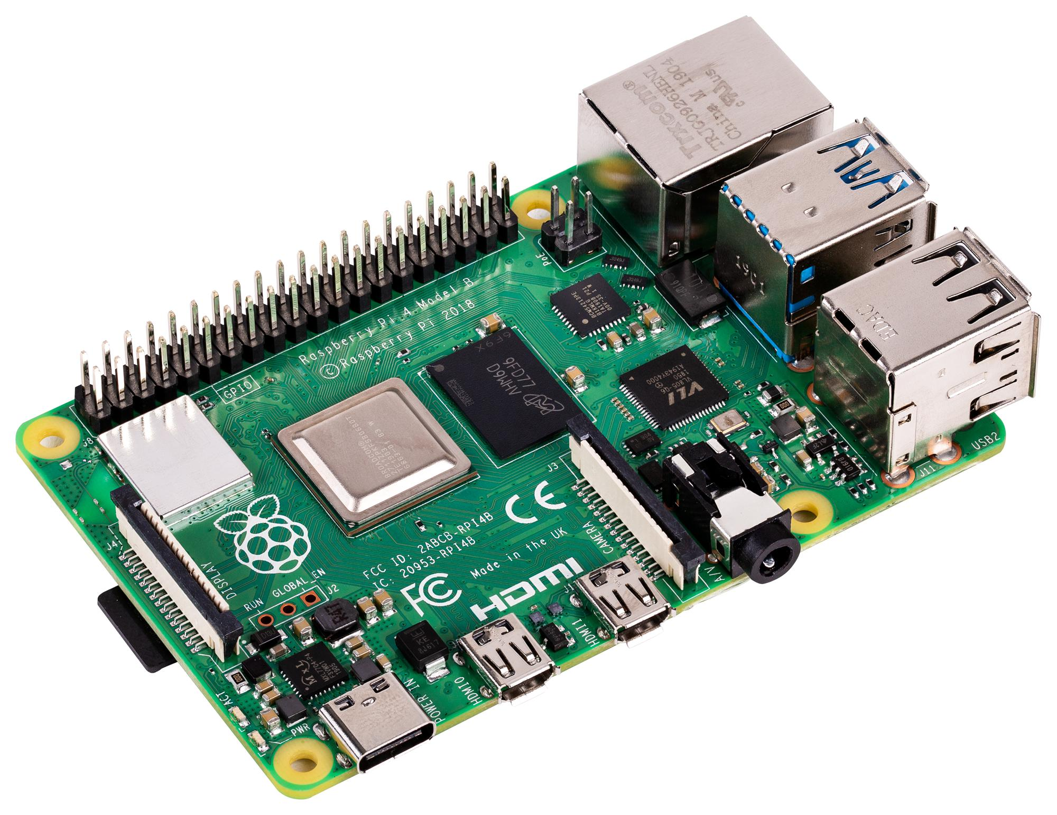
Raspberry Pi
Has all mentioned interfaces
Easily programmable in many languages
Not readily available for purchasing

Slide 11
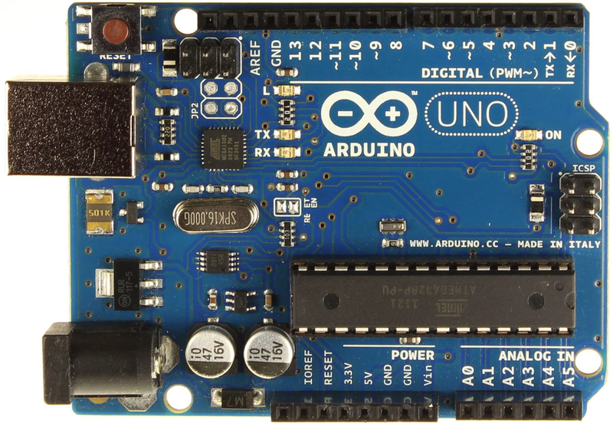
Arduino
Has all of the mentioned interfaces
C++ programmable
Lots of library support
Easily available to purchase

Slide 12
3.
Indicators

Slide 13

Requirements
Notify the user that an action was:
Successful
Failed
Waiting

Slide 14
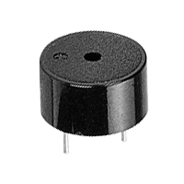
Speaker
Could use speaker for sound indication
Could also be used for flashy sound effects

Slide 15
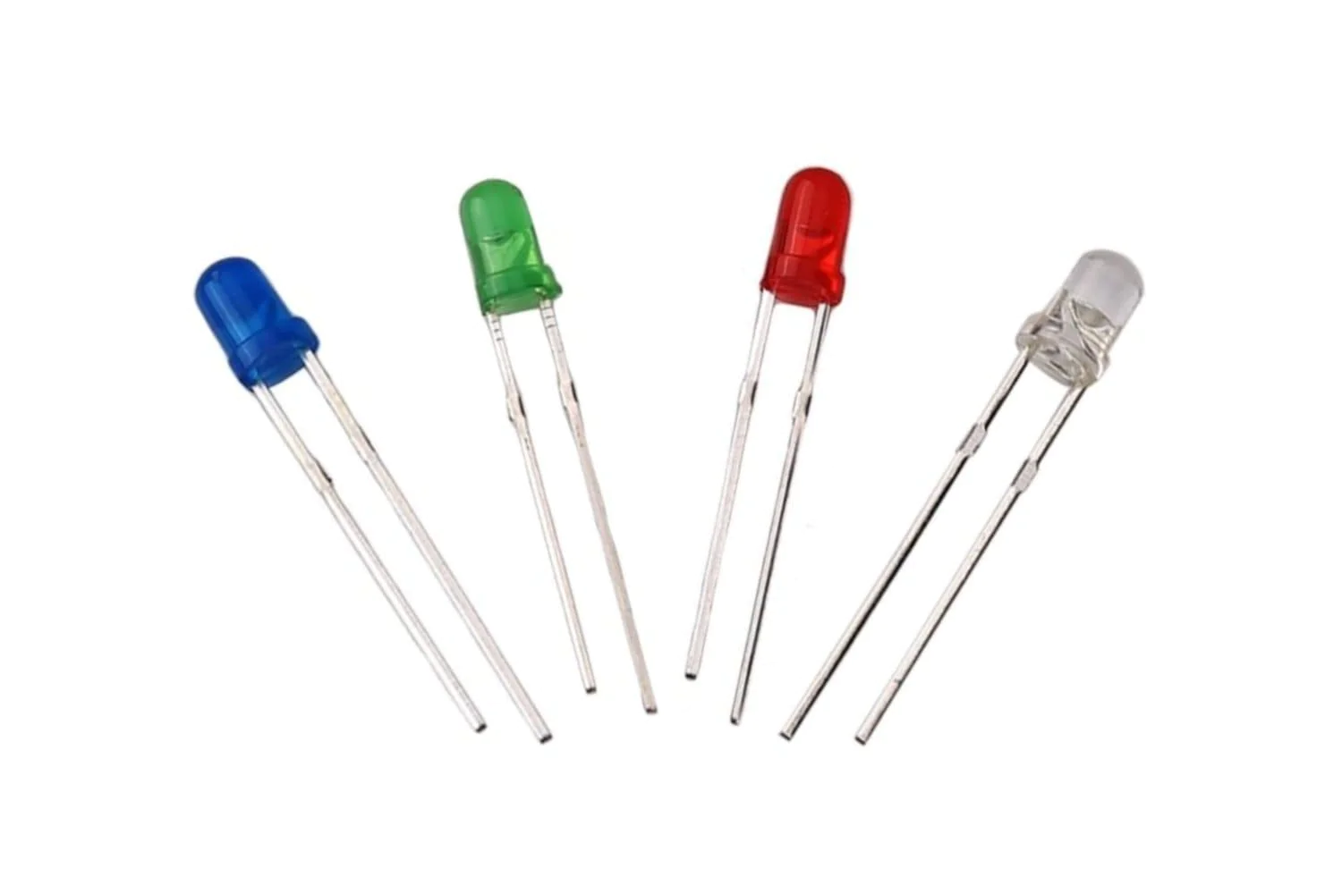
LEDs
Could use one multi-colored led
Could use multiple leds
Flashy/decorative lights

Slide 16
4.
Power Source

Slide 17
Requirements
Portable power source
Not cumbersome
Easily replaceable or rechargeable
Safe to handle
5 Volts
Able to handle significant current draw
Darrell Smith

Slide 18
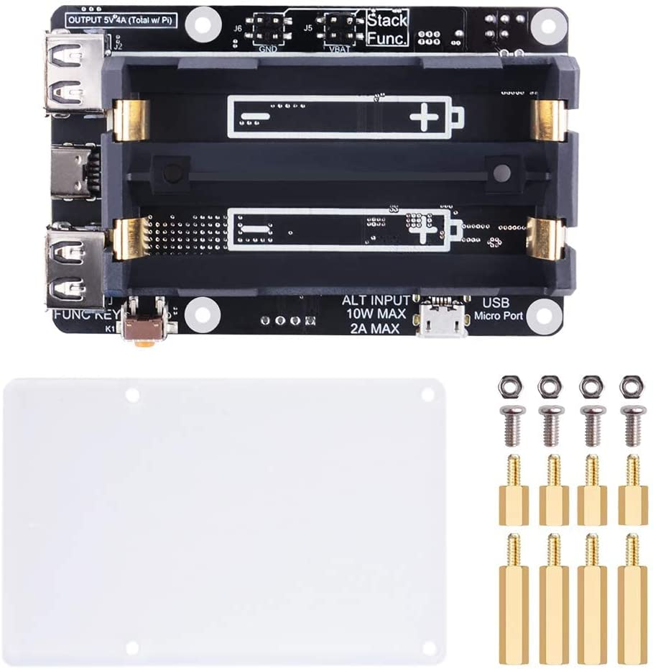
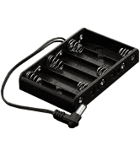
Replaceable Battery Pack
Darrell Smith

Slide 19
Replaceable Battery Pack
Pros
Portable
Batteries are easily replaceable
Easy to install
Some are codable
Cons
Possible safety issue due to opening
Continued cost of battery replacement
Possibly unreliable
Darrell Smith

Slide 20
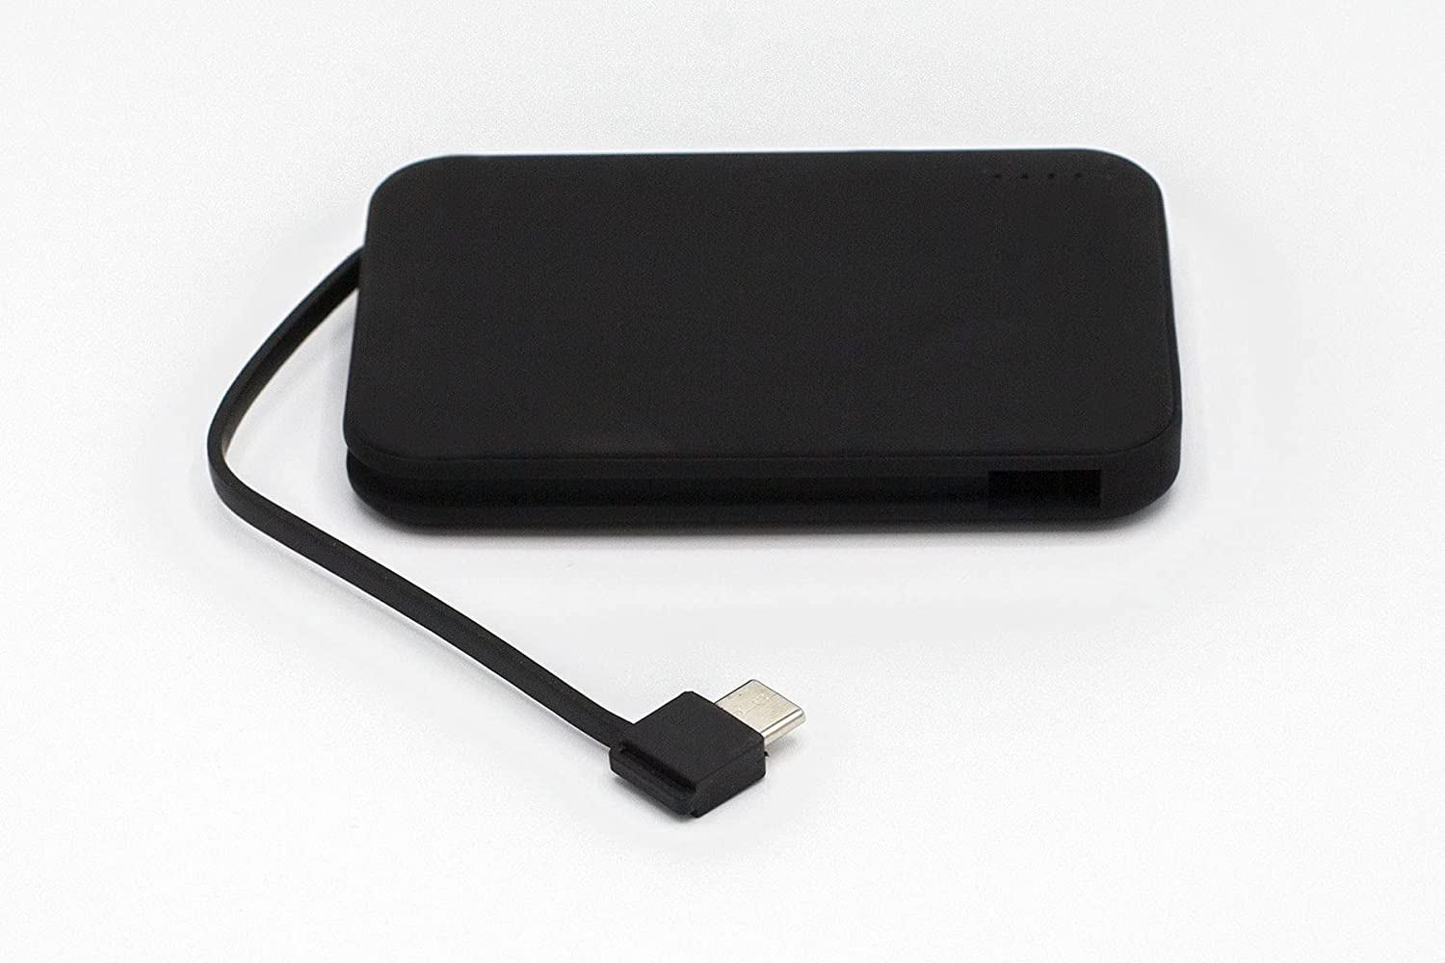
Rechargeable Battery Pack
Darrell Smith

Slide 21
Rechargeable Battery Pack
Pros
Portable
No continued cost
More reliable
Certain models can be coded
Cons
Must be charged regularly
More expensive
Harder to replace
Possible quality issues
Darrell Smith

Slide 22
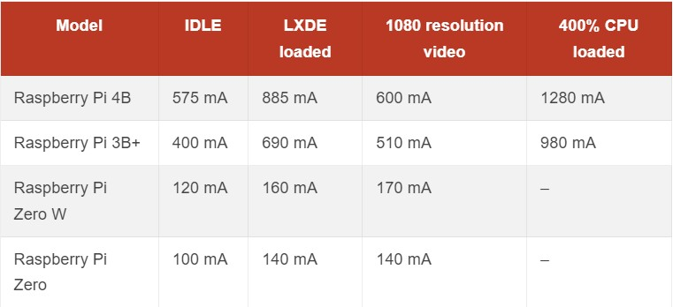
Raspberry Pi Current Consumption
Darrell Smith

Slide 23
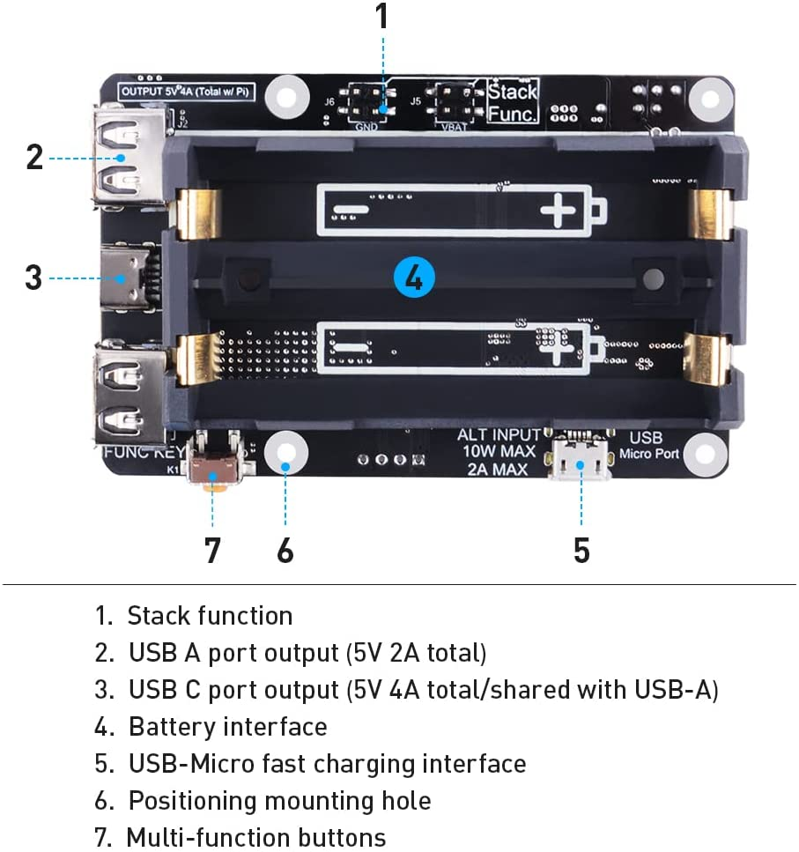
Promising Candidate
GeeekPi Power Supply
$38 - $43
Requires 18650 Batteries
Easily mountable and compatible to most Raspberry Pi models
May require its own cooling unit
Codeable restart feature
Darrell Smith

Slide 24
Promising Candidate
VGE Battery Pack
$25
Requires USB-C cord
Easily mountable and compatible to most Raspberry Pi models
4+ hour battery life
Darrell Smith

Slide 25
5.
Scanner Module

Slide 26
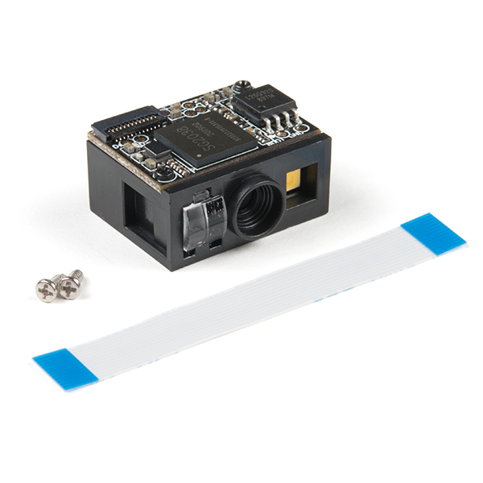
Requirements
Capture and digitize reflected light from battery barcode
Camera and a light source
LED’s attached for indicators
Usable with I2C

Slide 27

Barcode
Exclusively battery barcode
Indicators to confirm/deny barcode scan
Working barcode to translate data

Slide 28
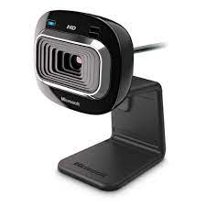
Camera
Needs to be coded to only respond to those barcodes
Must have accompanying light source
Must be triggerable by microprocessor
Durable

Slide 29
6.
Flashy Decor!

Slide 30
Requirements
“Look powerful, awesome, and hilarious.”
Project Prompt
Applied only when project is fully functionable
Still able to function when applied
Employers find it easy to use

Slide 31
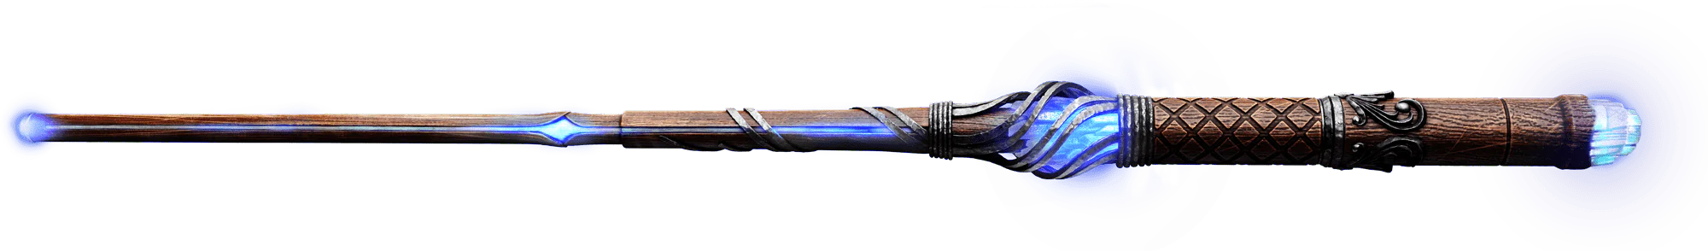
Magical Scanning Wand
Lights running the length of the scanner
“Wooshing” sound effects
Possible flick to scan

Slide 32
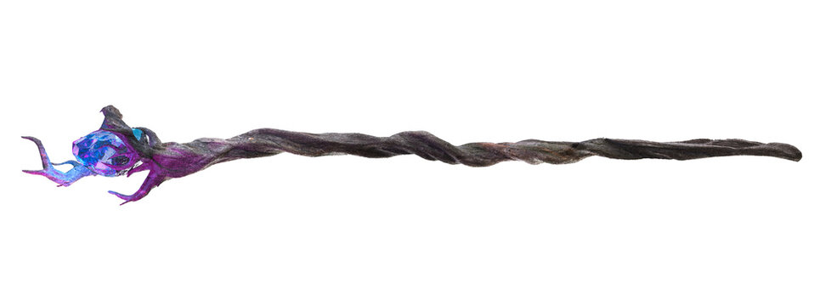
Magical Scanning Wand(Staff)
Scanner fits into staff stick when wanted
“Wooshing” sound effects
Lights in end of staff
Button on lower staff for ease of use

Slide 33
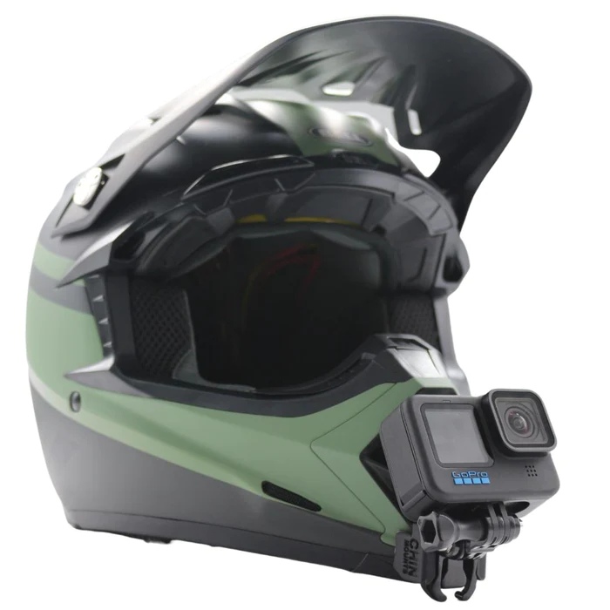
Helmet Scanner
Hands-Free: Scanner doesn’t have to be held
Protects worker while using
Optionally could have worker bang head on QR codes/barcodes (Not responsible for injuries)

Slide 34
Thanks!
Any questions?

